Slide 1
Power BI Some Features
Session 9
Farha Imthiyaz,
BSc (Hons) in Software Engineering
(Solent University, UK),
MS in Data Science (Reading)
(NED University of Engineering & Technology, Karachi)

Slide 2

Road Map
What is Power BI
Example Scenario
Features we used in Power BI
Data Mining
What-if Analytics
Predictive Analytics
Drill Down
Slice and Dice
Data Visualization (Dashboards)
Statistical Analysis
Summary

Slide 3

What is Power BI
Power BI is a business analytics service by Microsoft.
It aims to provide interactive visualizations and business intelligence capabilities with an interface simple enough for end users to create their own reports and dashboards.

Slide 4
Example Scenario
NOLIMIT is a largest company in the area of Fashion and Design in Dress culture. It has a number of branches in different location in all over the Sri Lanka, each typically entrusted with selling and distribution of products. Its data warehouse includes a number of data marts, one of which dedicated to commercial analysis and cantered on a sales cube with dimensions Month, Product, Customer, and Branch.
For this Presentation we used NOLIMIT Sample data to analyze Power BI main Features (Techniques)

Slide 5

Features we used in Power BI
Data Mining
What-if Analytics
Predictive Analytics
Drill Down
Slice and Dice
Data Visualization (Dashboards)
Statistical Analysis

Slide 6
1. Data Mining
Data mining is the process of analyzing data from different sources and summarizing it into relevant information that can be used to help increase profits and decrease costs.
Data mining we consists five major elements. They are Extract, transform, load, Store and manage.
In here we use ETL method

Slide 7
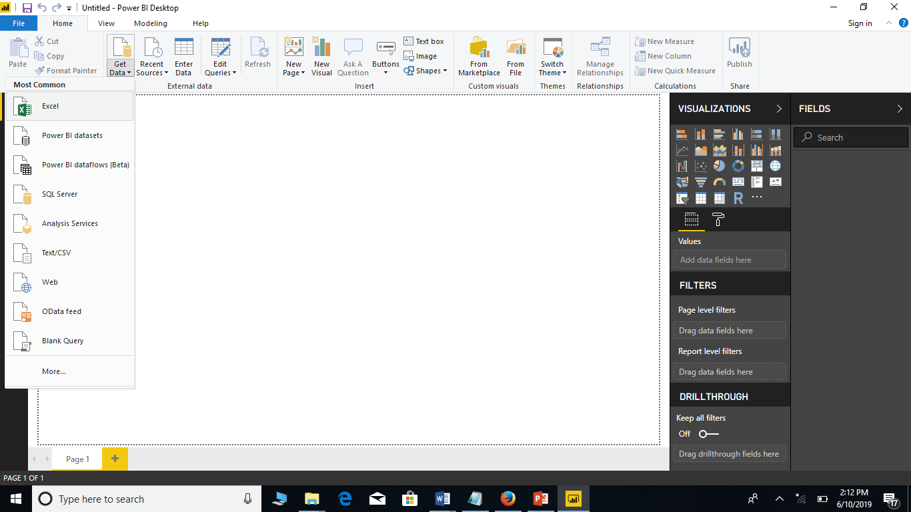
E- Extract in ETL

Slide 8
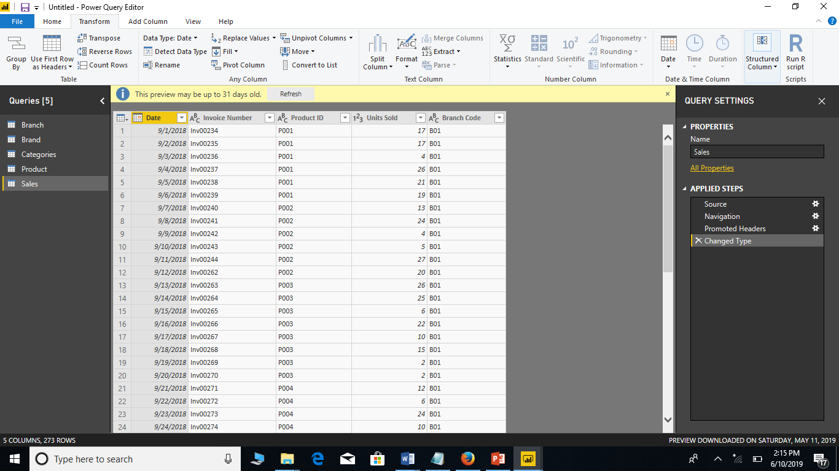
T- Transform in ETL

Slide 9
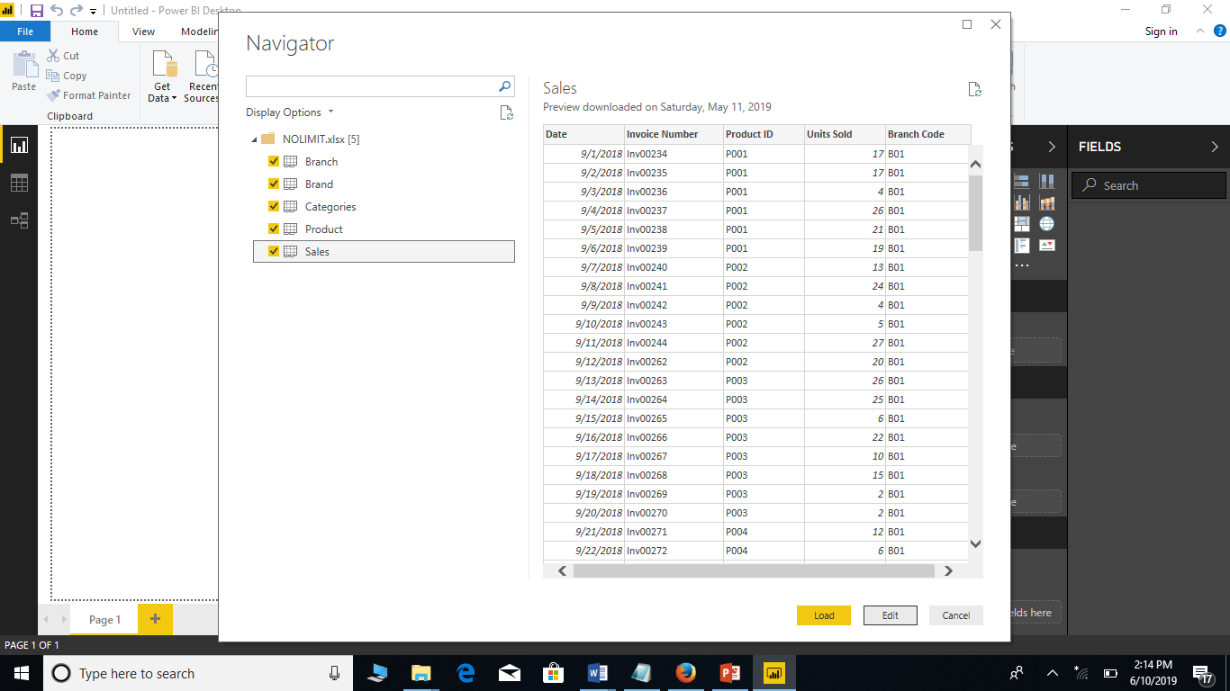
L-Load in ETL

Slide 10
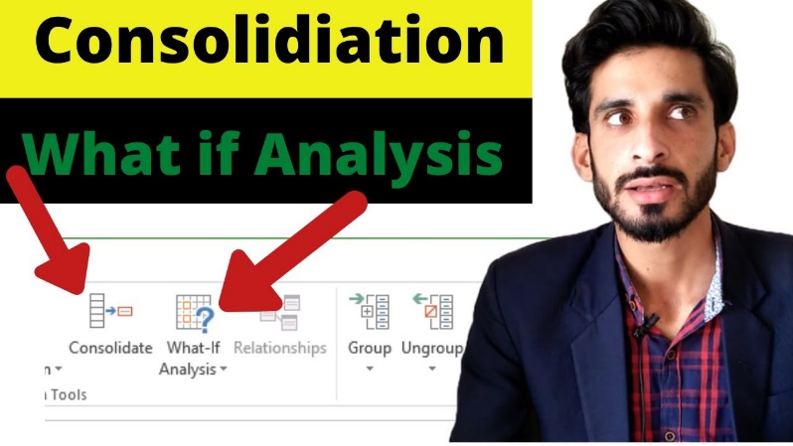
2. What-if
A what-if analysis is a technique that is used to determine how predictable performance is affected by changes in the assumptions that forecasts are based upon.

Slide 11
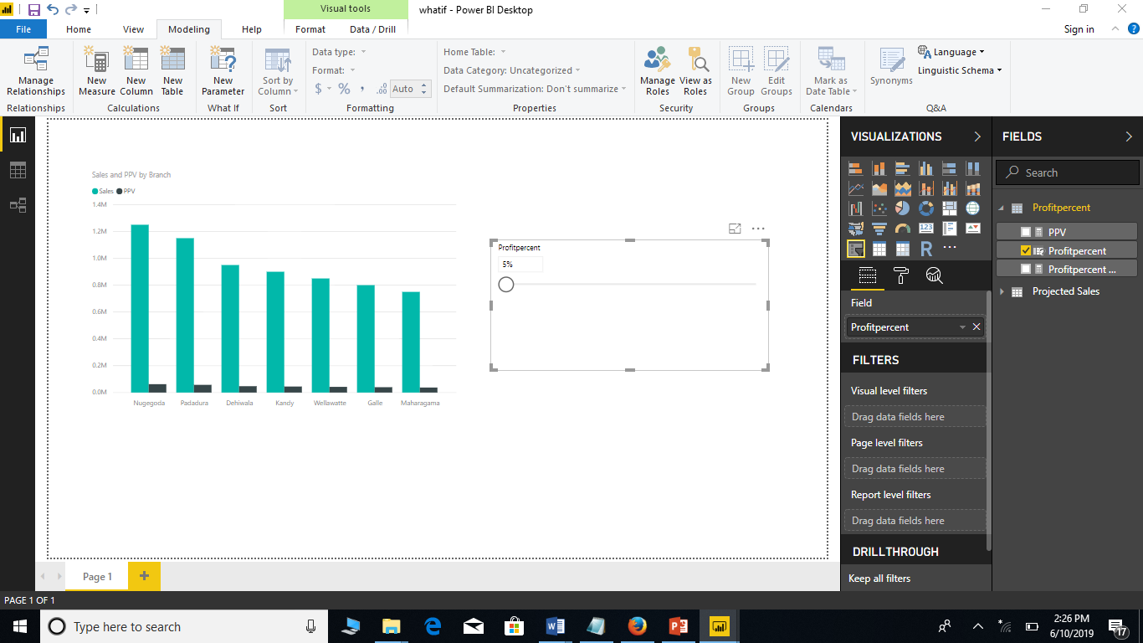
If the profit percentage of NOLIMIT is 5% meant the column chart shows the total profit of all the branches.

Slide 12
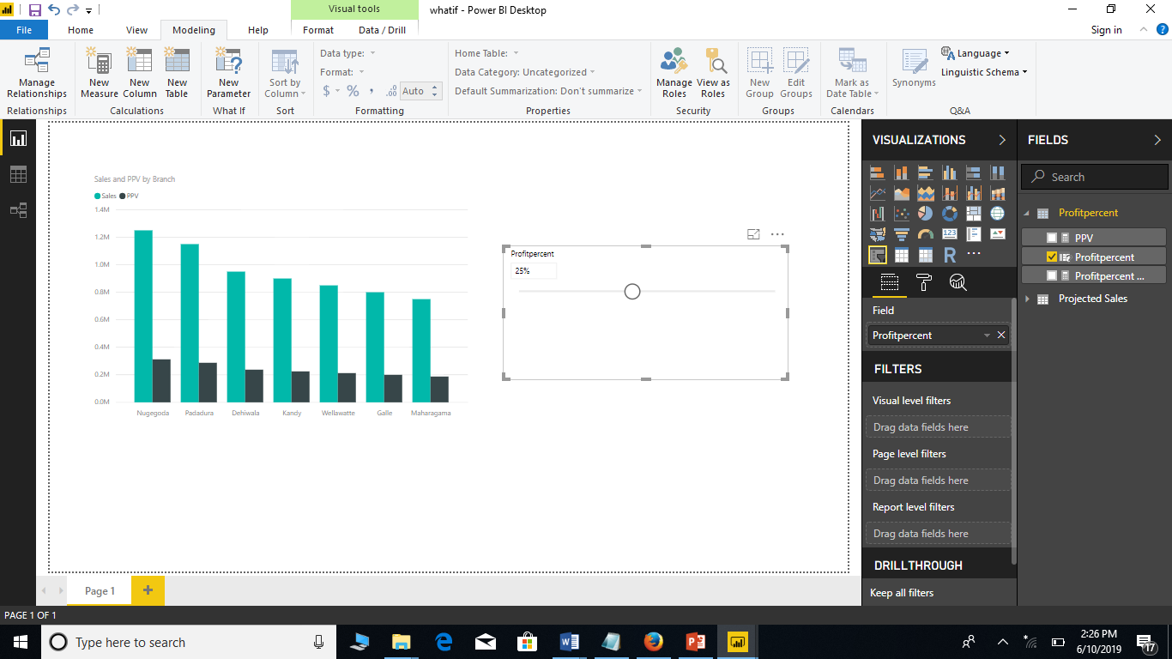
If the profit percentage of NOLIMIT is 25% meant the column chart shows the changes of the total profit of all the branches.

Slide 13

3. Predictive Analytics
Predictive analytics is the practice of extracting information from existing data sets in order to determine patterns and predict future outcomes and trends.

Slide 14
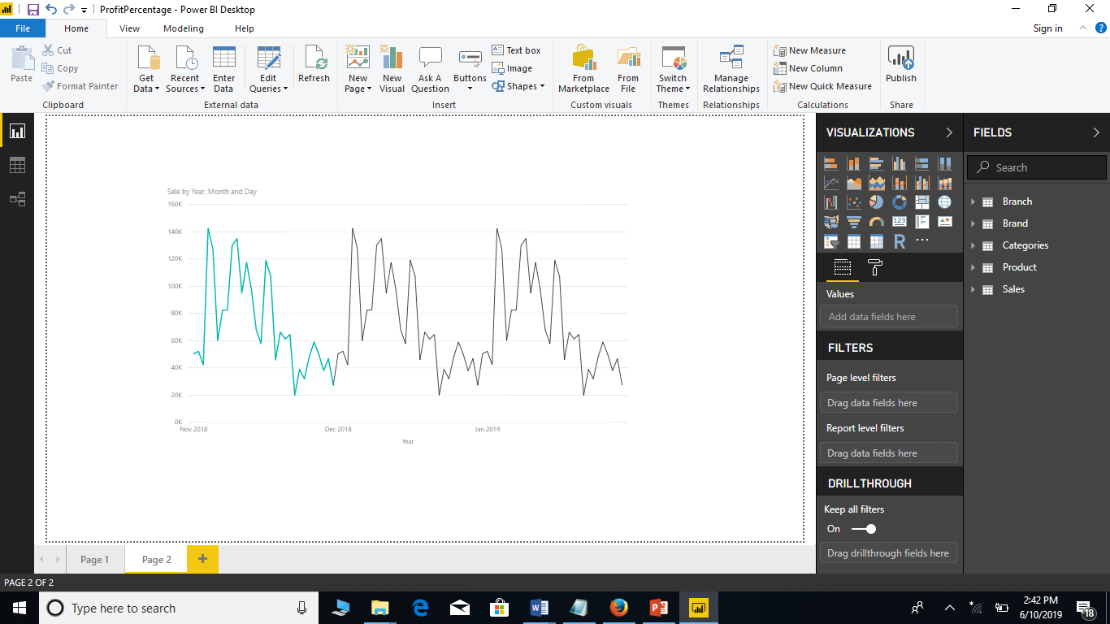
In here, we have November month sale data of NOLIMIT. from this prediction we will identify the next two months sale data.

Slide 15
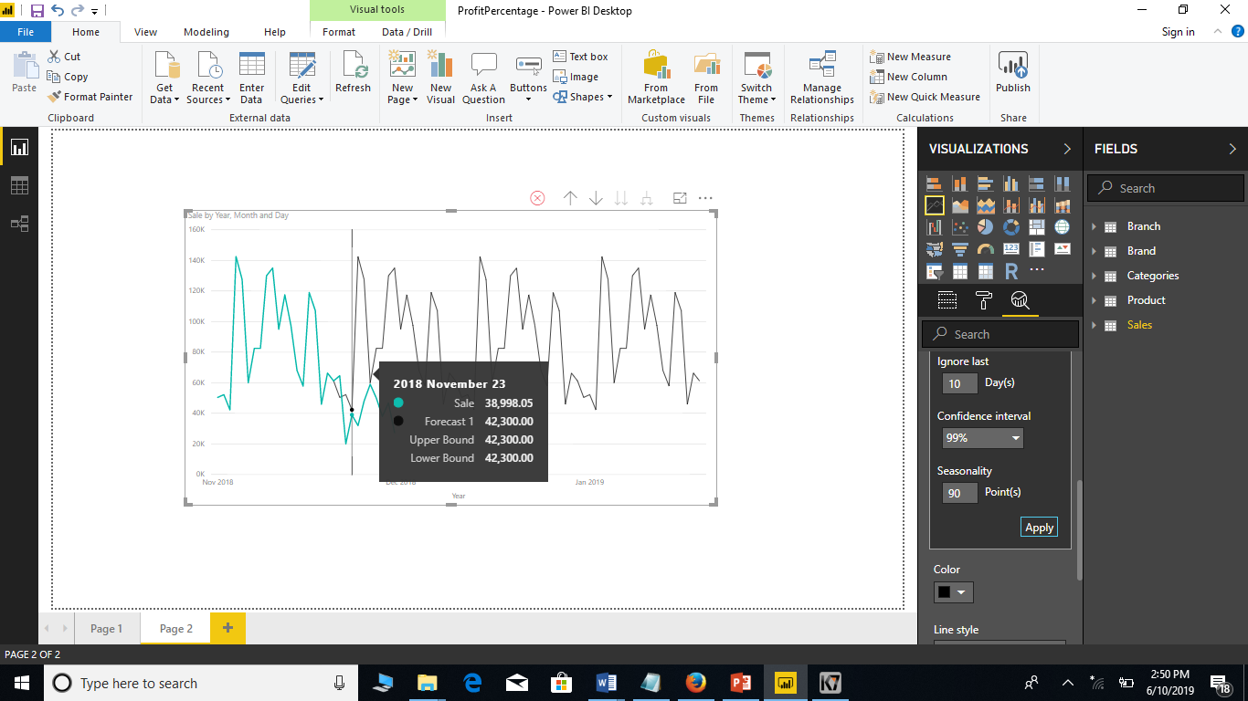
In here, from ignore last option we can compare real sale and forecast sale.

Slide 16
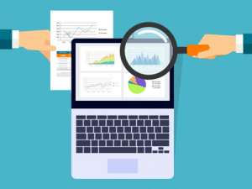
4. Drill Down
Drill down is a capability that takes the user from a more general view of the data to a more specific one at the click of a mouse.

Slide 17
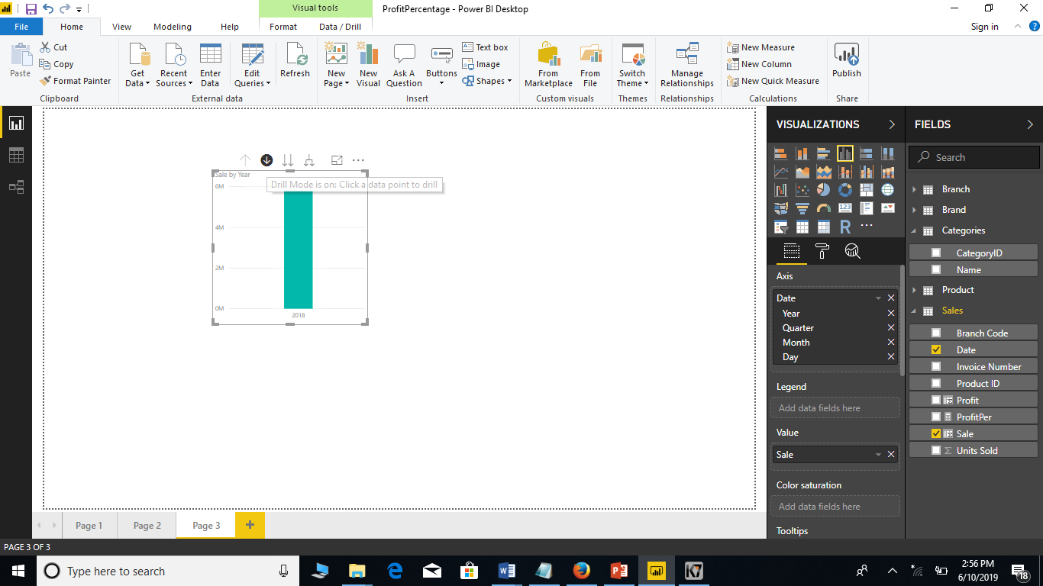
This figure is more general year (2018) view of NOLIMIT total Sale.

Slide 18
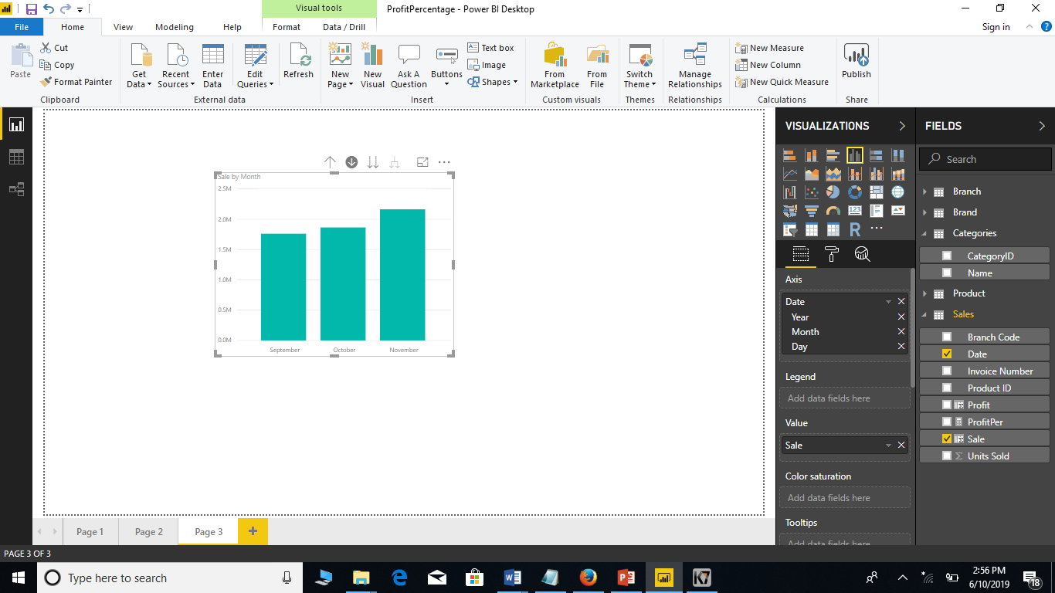
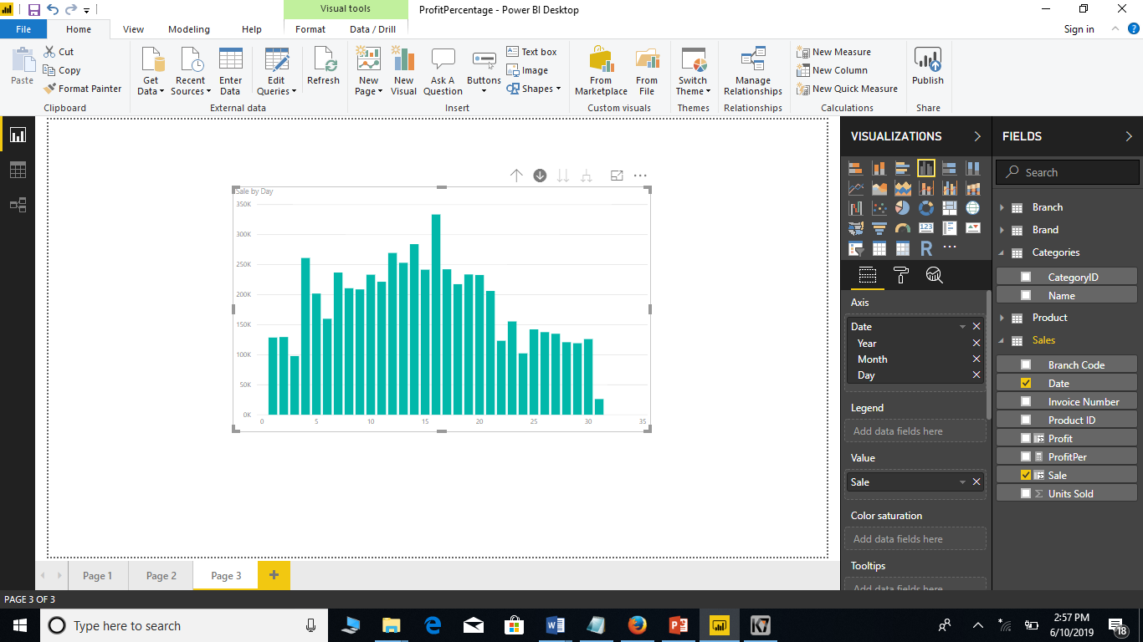
These figures we can view more specific view of NOLIMIT total Sale. Such as Months and days..

Slide 19
5. Slice and Dice
Slice and dice is to break a body of information down into smaller parts or to examine it from different viewpoints so that we can understand it better.

Slide 20
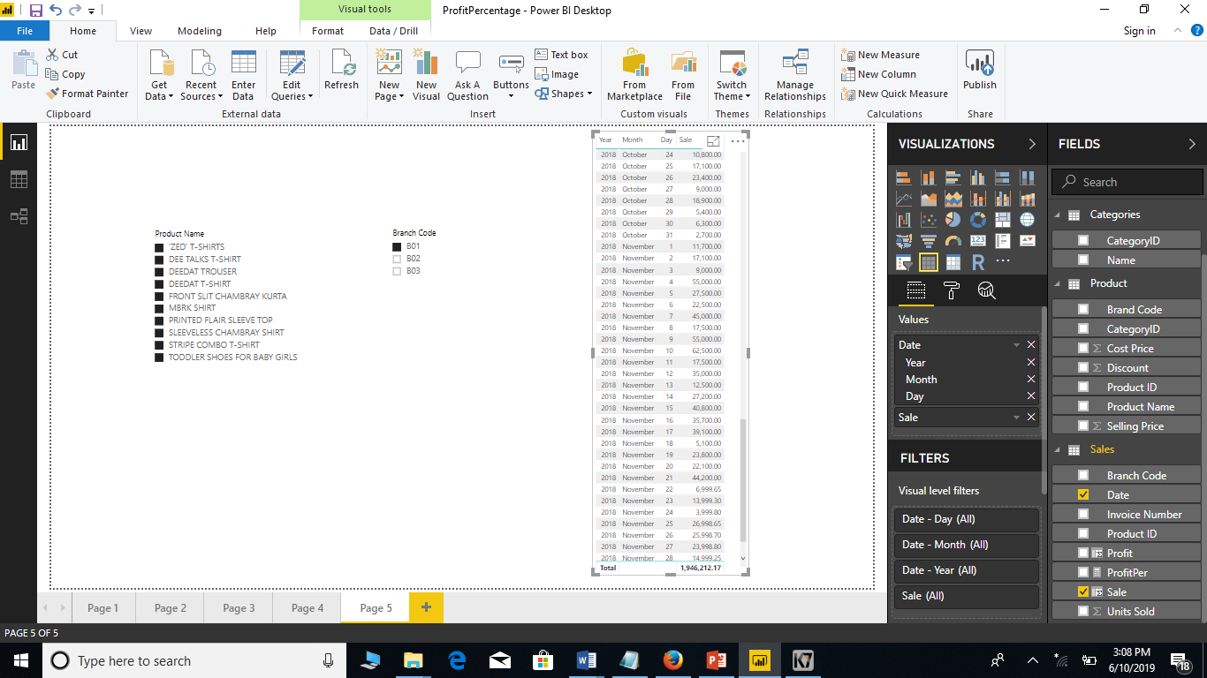
In NOLIMIT if we select all the products with B01 Branch code meant near table will filter with Products and Sale. So, total Sale is 1946212.17/=

Slide 21

In NOLIMIT if we select all the products with All the Branch code meant near table will filter Products and Sale. So, total Sale is 5791835.879999999/=

Slide 22
6. Data Visualization (Dashboards)
Data visualization is the process of displaying data/information in graphical charts, figures and bars.

Slide 23
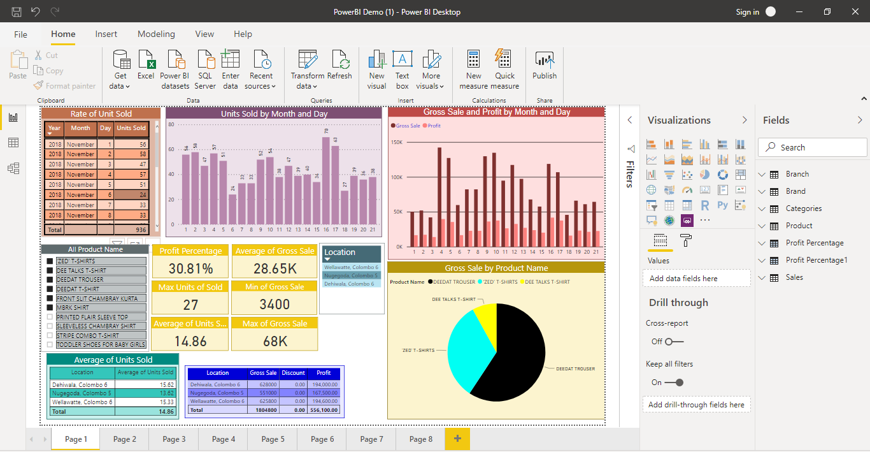
This figure is a dashboard of NOLIMIT sale.

Slide 24
7. Statistical Analysis
The practice or science of collecting and analyzing numerical data in large quantities, especially for the purpose of gathering scopes in a whole from those in a representative sample. In here we use Average, Total, Median and etc.
In here, Sale and Profit equations are also we can include in statistical Analysis.

Slide 25
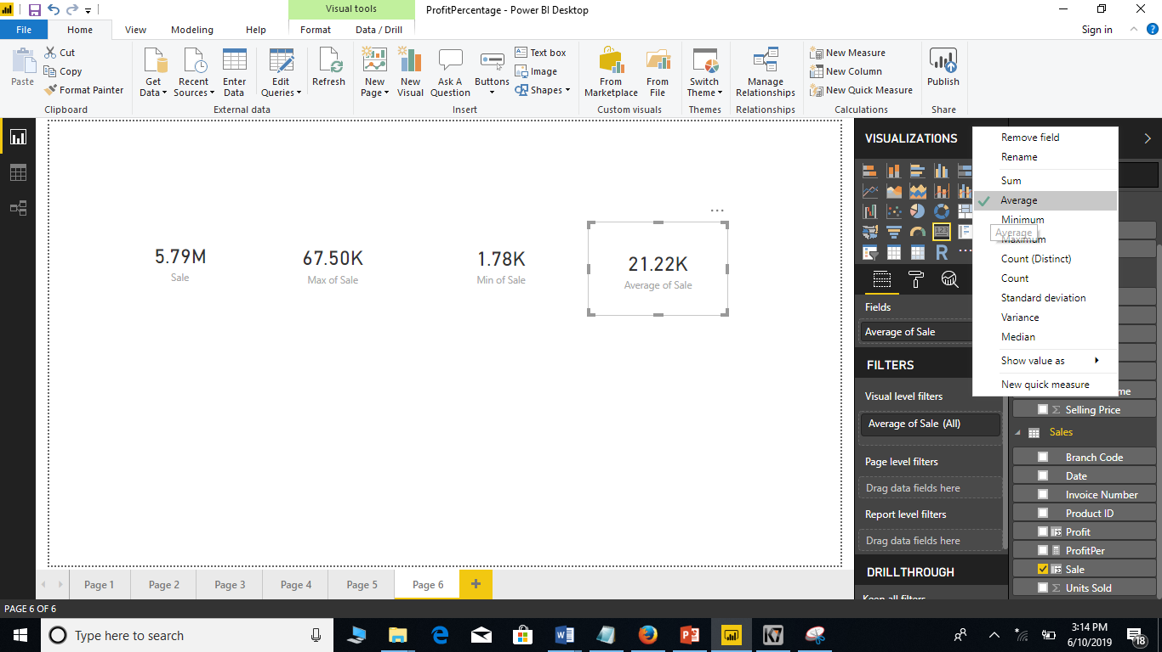
In here, we include Sale of NOLIMIT in different statistical Analysis. They are Sum of Sale, Max of Sale, Min of Sale and Average of Sale.

Slide 26

Summary
Power BI is the best Business Intelligence tool for business visualizations and business intelligence capabilities with an interface simple enough for end users to create their own reports and dashboards.
We have discussed in this presentation some of features which we used in our example scenario with screen shots.

Slide 27


